Slide 1

eCommerce Customer Segmentation

Slide 2

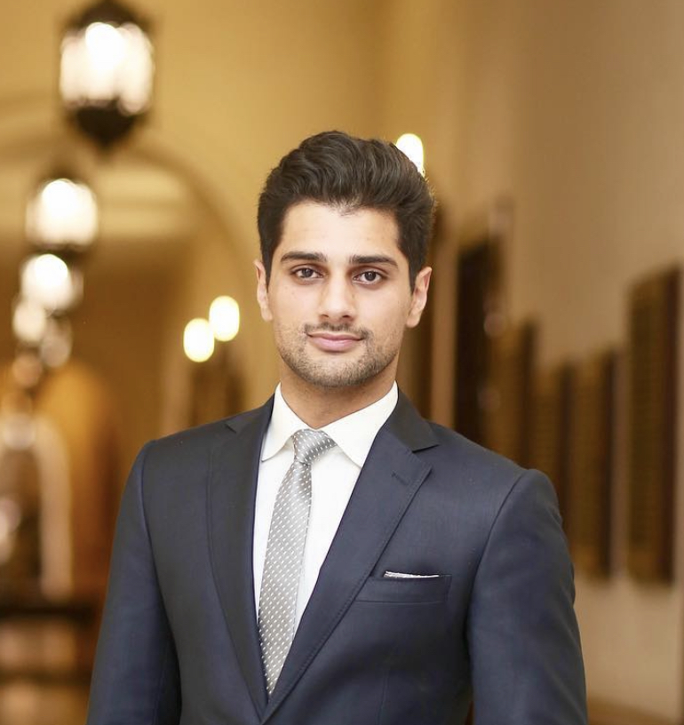
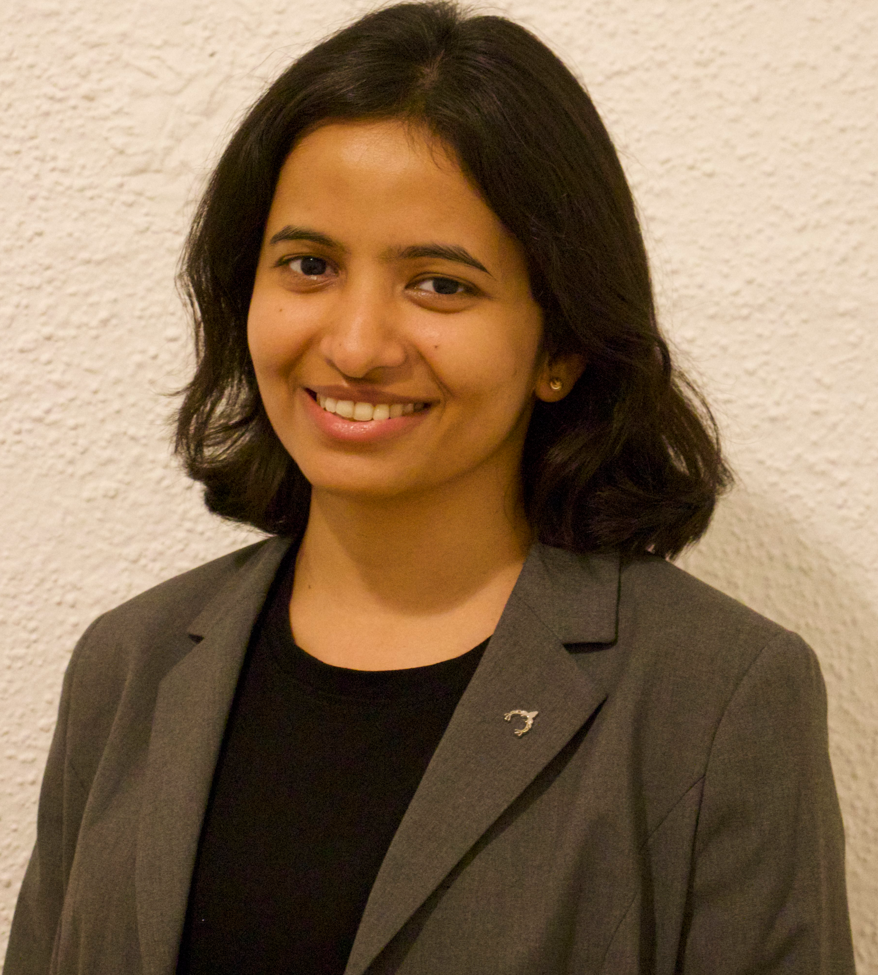
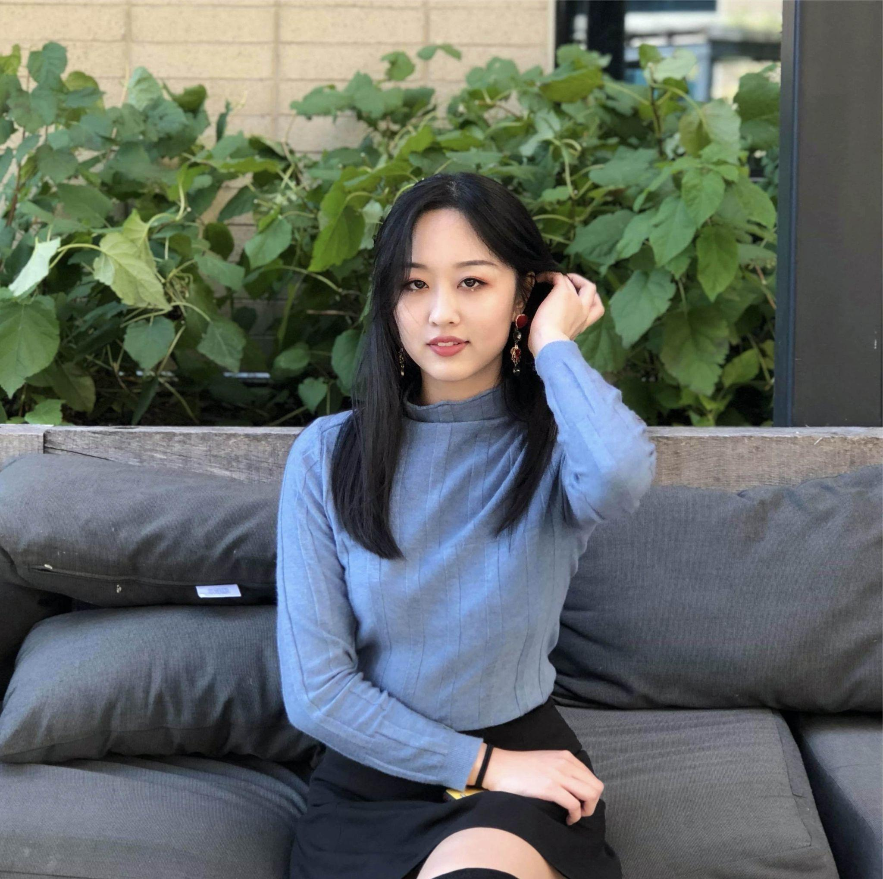

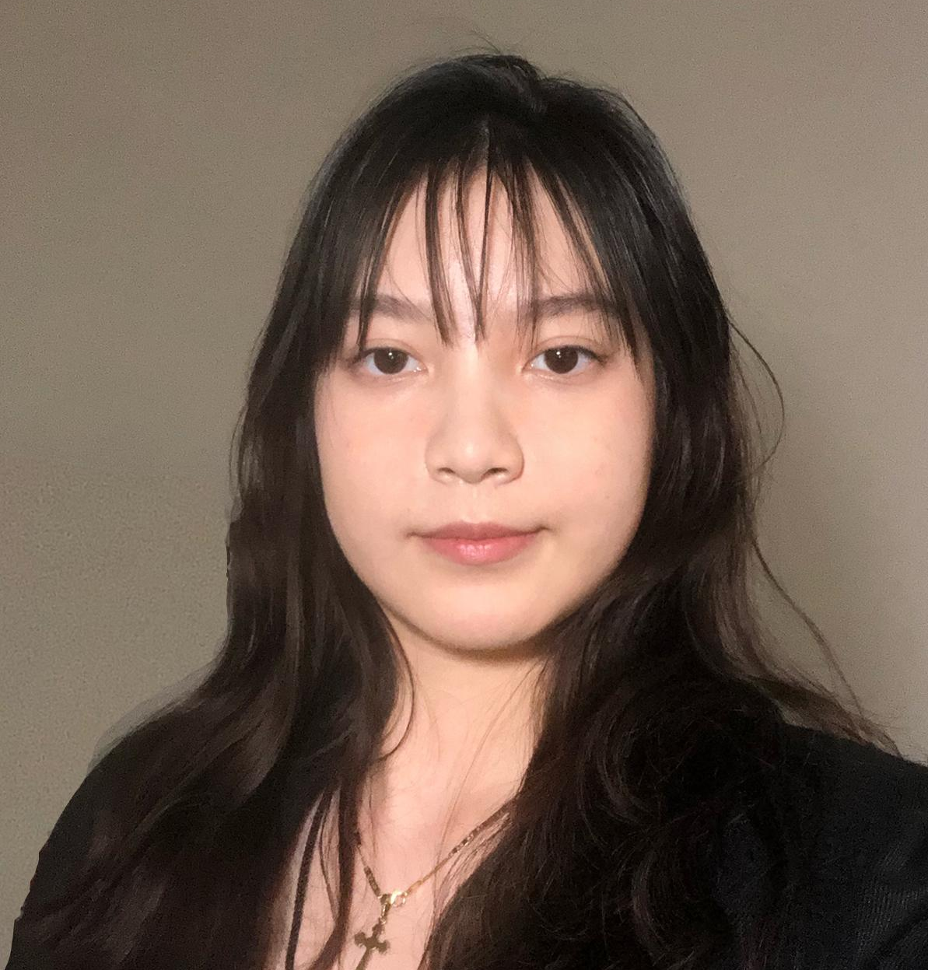
Meet Our Team
Hyojun Kim
Salman Yousaf
Preetika Parashar
Isabella Xue
Danhong Huang
Yun Xing
Vice President of Data Science
Data Engineer
Data Scientist
Vice President of Webmaster
Consumer Insight Manager
Business Analyst

Slide 3
Agenda
1. MDATA Goal
2. Model Results
3. Segmentation
4. Business Analysis
5. Next Steps
03
Notes:
Note: you can add between 3 and 6 sections, the structure can vary. The numbers have to be kept

Slide 4
MDATA Goal
We shall deliver +20% incremental sales (w/ SMART)
Target the top 15% of customers
Intelligent strategic customer segmentation and marketing
Keep track of 30/60/90 - day periods of growth
Lead to a sustainable increase in the overall revenue
Improve customer retention and website engagement
Notes:
* Mission: To create the smartest marketing strategies and best customer experience *

Slide 5
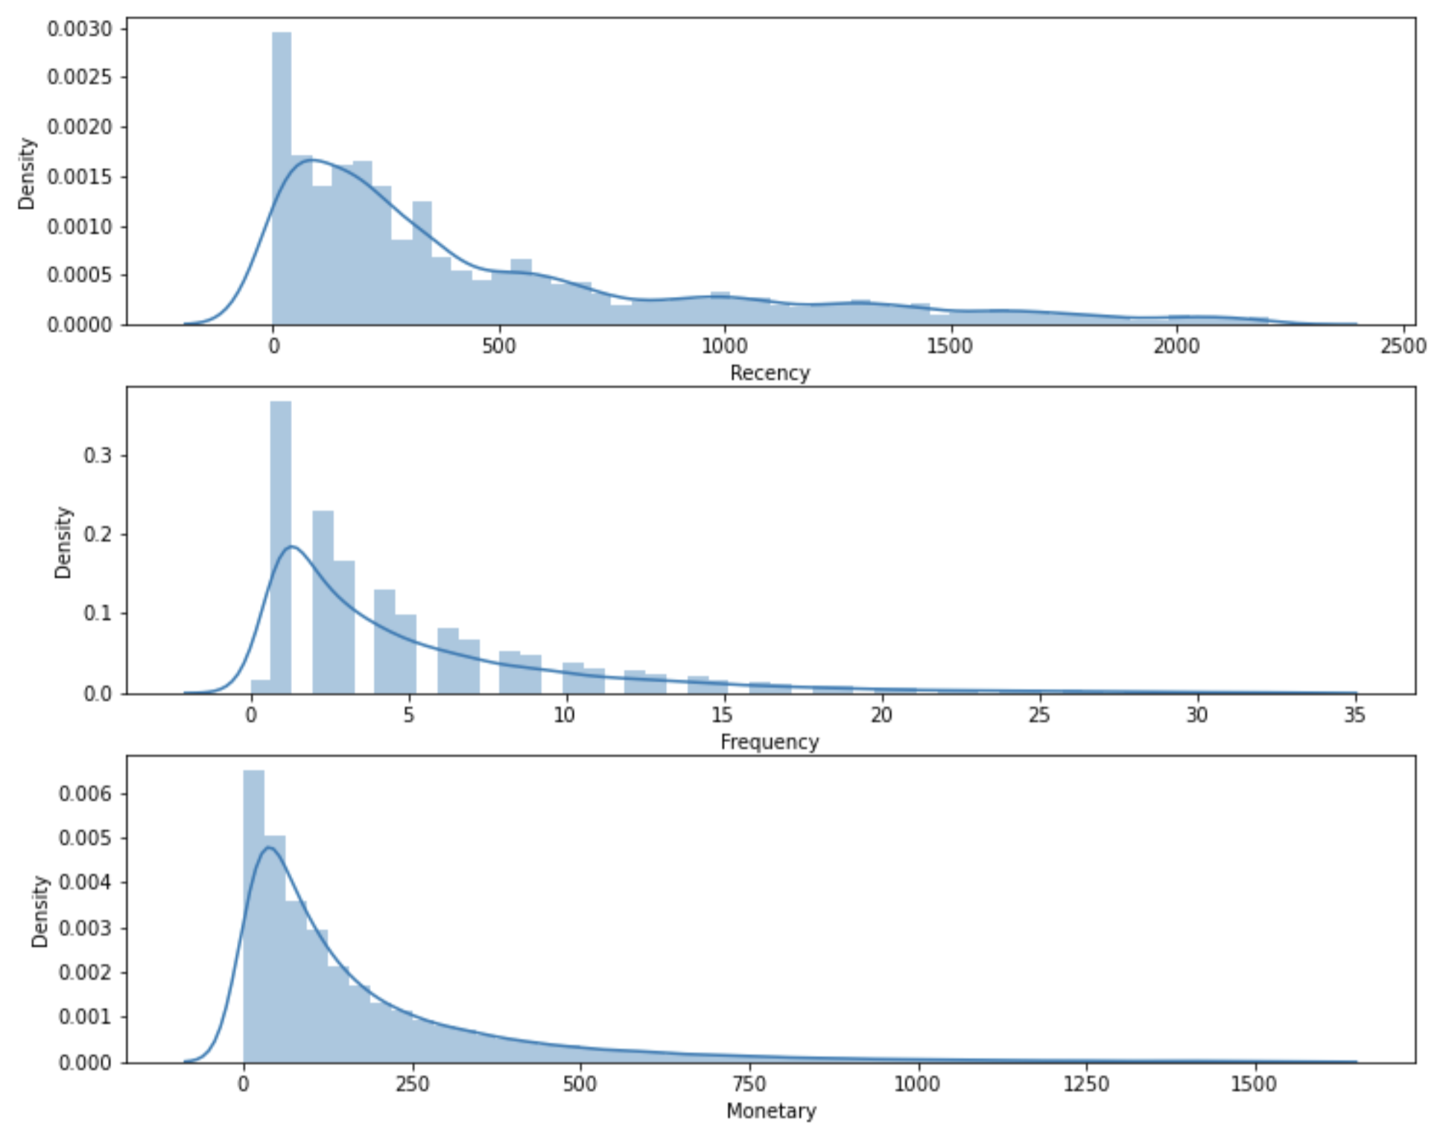
RFM Model
Recency
Frequency
Monetary Value

Slide 6
RFM Segment | RFM Score | Segmentation Proportion
Can’t Lose Them | 12 or above | 7.4%
Champions | Between 11 and 12 | 8.0%
Loyal/Committed | Between 10 and 11 | 10.5%
Potential | Between 9 and 10 | 10.4%
Promising | Between 8 and 9 | 11.5%
Requires Attention | Between 6 and 8 | 25.2%
Demands Activation | Below 6 | 27.0%

Slide 7
Segmentation

Slide 8
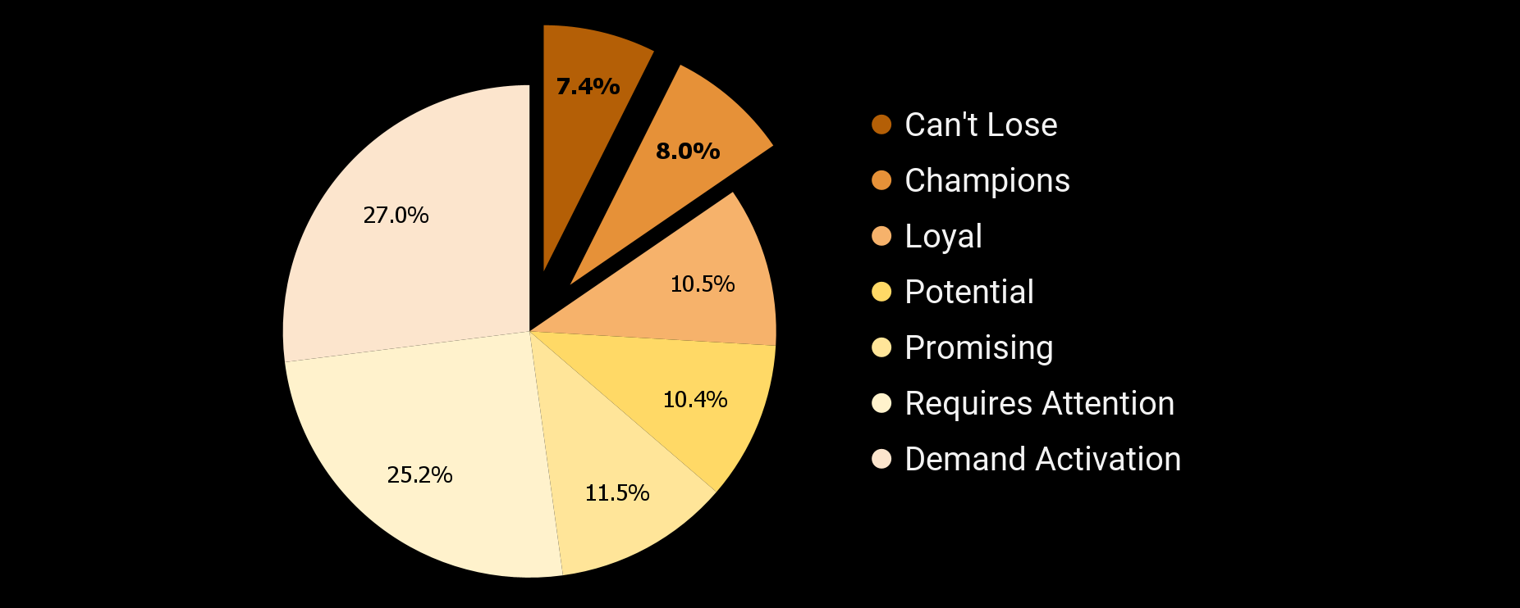
Customer Segmentation
Notes:
I would like to direct your attention to the top two segment: can't lose and champions, they are our top 15% customers and we are confident that implementing new strategies for them would be the most beneficial.
To better understand our top segments, we conducted individual interviews and online quantitative surveys with our top customers and sum up into 2 slides of persona.

Slide 9


Bibliophile — Can’t Lose Them (Top 7%)
Demographics
Age: 25-40
Gender: 66% male
Education: Master or above
Lifestyle & value
Lifetime reader
Value knowledge and truth
Critical thinkers
Spend a lot on books each month
Behavior
Recency: 217 d
Frequency: 11.6
Monetary: $552
IDI Interviewee: Eric Connor
27 y.o., Uchicago, Researcher
Notes:
One of our top segment is can’t lose them, we call them bibliophile (This is a delicate word, meaning someone is fanatical about books)
This segment of customer are aged between 25 to 40, mainly male and well educated. They are those person we might meet irl who
1. Like reading books from a very young age.
2. sometimes enjoy staying inside their bubble.
3. They are critical thinker and
4. Book expenditure takes a large part in their monthly costs
From our original data, the mean recency of them is 217 days, the frequency is 11.6 times and they spend more than 500 dollars in total, which are all more significant than other segments.
One of our interviewees is Eric. He is 27 years old, and working as a researcher in Uchicago.

Slide 10
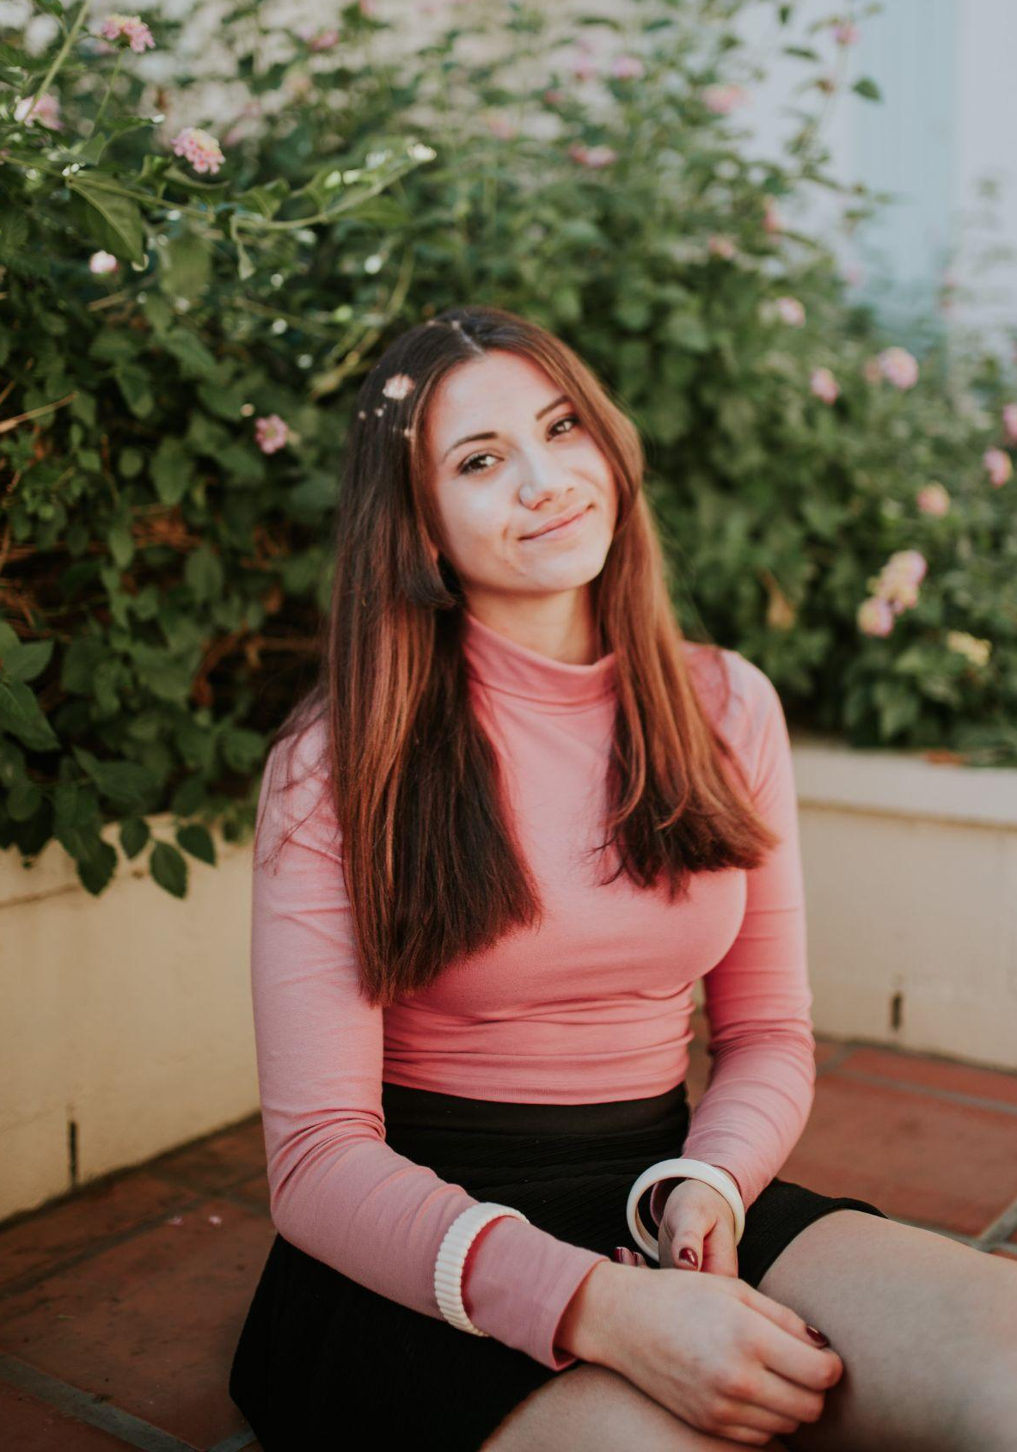
Book Collector — Champion (8%)
Demographics
Age: 20-30
Gender: Neutral
Education: Bachelor or above
Lifestyle & value
Love collecting books (may not read them)
Enjoy learning, curious, sociable
Behavior
Recency: 431 d
Frequency: 4.5
Monetary: $165
IDI Interviewee: Eleanor Thompson
22 y.o., SAIC, Freelance writer
Notes:
Now let’s move on to our the second segment, Champion, we call them Book Collector
They are relatively younger than bibliophile and there is no significant gender tendency. They are usually holding a bachelor degree or above
They love collecting books, but may not really read them, cuz the well set-up bookshelf filled with books gives them a sense of satisfaction.
They enjoy learning, and also very curious and sociable kind of person.
From our original data, the mean recency of them is 431 days, the frequency is 4.5 times and spend average 165 dollars in total,
One of our interviewees is Eleanor. She is 22 years old, and working as a freelance writer.
Now, let me pass on to Isabella, who will elaborate our solutions and strategies.

Slide 11
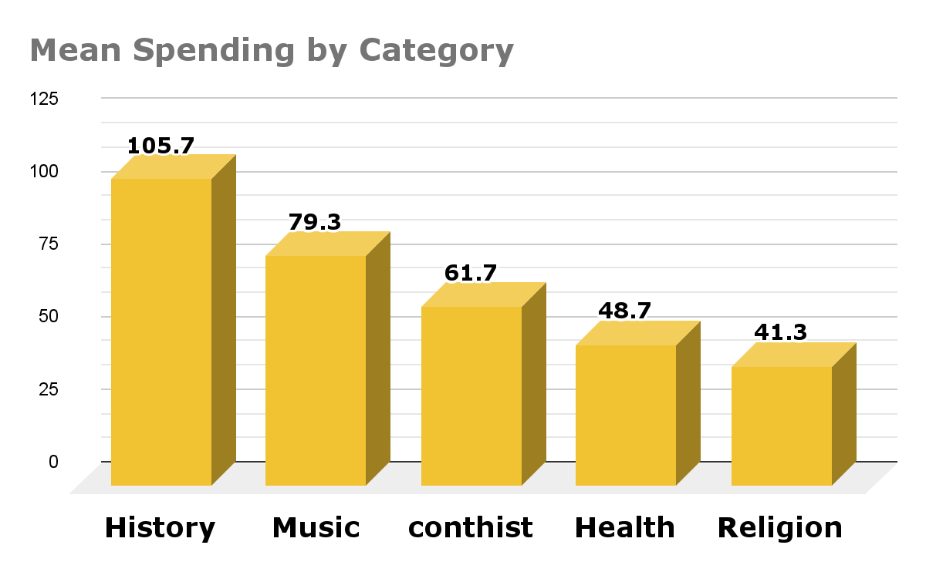
AI Solution
Create loyal customer program
For our Erics (Top 5%):
Recommendation based on past purchase history
Customized to each customer
For our Eleanors (Top 6-15%):
Recommendation based on top 15% customers past purchase history
Based on the cohort average
Notes:
First, we would like to present the new recommendation engine. To maximize the financial gain, we propose the following AI solution. The website need a loyal customer program keeps track of who is our Erics and Eleanors.
And for Erics, we would recommend books based on what categories did they used to prefer. The recommendation is customized to each customer.
For our Eleanors, the website would recommend based on what categories do the whole group prefer (that are the most popular categories). The difference between Erics and Eleanors is that the recommendation for Eleanors is derived from the cohort average.

Slide 12
Marketing Strategy
Marketing Strategy
General strategy for top 15%:
Occasional offline exclusive events to get writers’ signed books
Website gift cards
Free shipping (others: at least $50)
Promotion focus on specific categories
For Erics:
Write reviews for a book, get double credits
Recommend collective/limited editions for them (e.g. book series from their favorite author)
For Eleanors:
Refer a friend, get one book for free
Notes:
Next, we move on to our new marketing strategy. For all our top customers, we would provide offline exclusive events, giving out gift cards, free shipping with no minimum, and most importantly, the promotion would be tailored based on their favorite book categories.
We also plan to tailor our strategy based on the VIP status. The following plan is designed using the portrait of each group. It is only preliminary, and we would modify based on the market reaction as we keep track of periods of growth.

Slide 13
Business Analysis

Slide 14
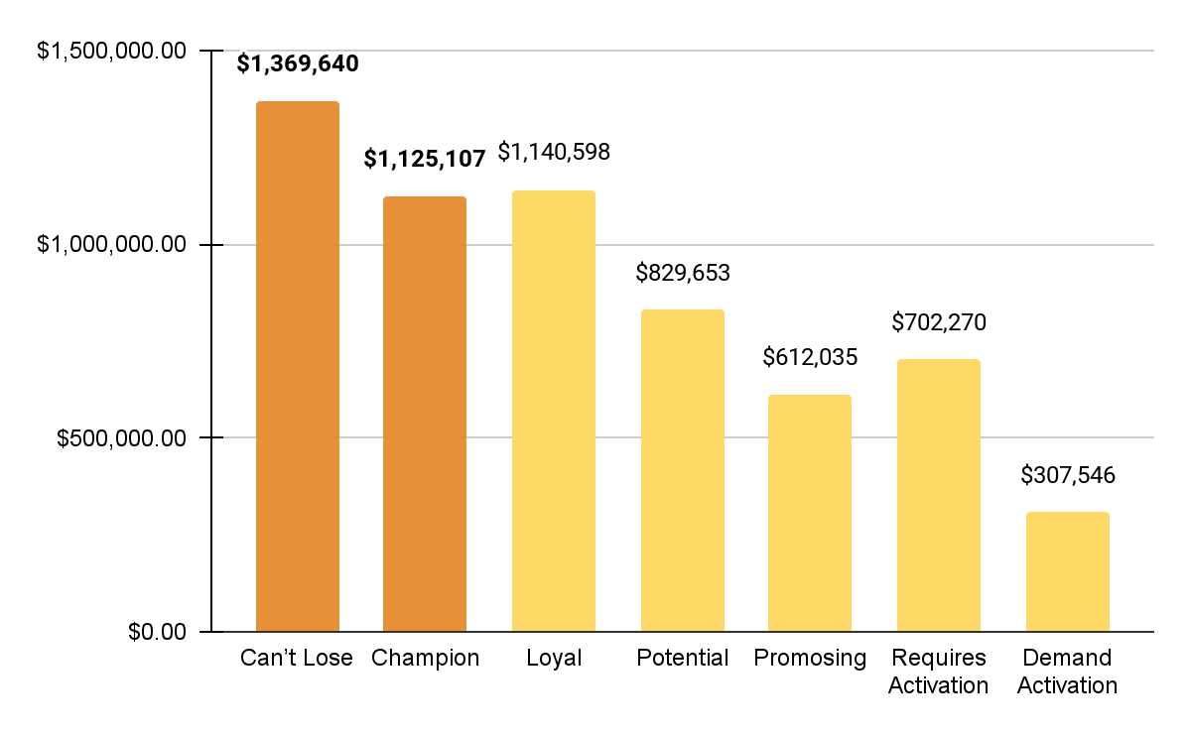
Revenue from Customers
Total:
6.1 M
Top 15% customers:
2.5 M
41% of total
Others:
3.6 M
59% of total

Slide 15
What We Expect: Revenue Increase
Top 15% Customers
Others
Current Revenue
6.1 M
2.5 M
3.6 M
+680 K
+500 K
+180 K
2.9 M
New Revenue
3.8 M
6.8 M
20% sales increase
for top 15% customers
5% sales increase
for others

Slide 16



Next Step
Quality Assurance
Success
Implementation
AI solution
and Marketing Strategies
Satisfied Customer
Revenue Increase
Surveys for customers Growth check (30/60/90 days)

Slide 17
Thank you

Slide 18
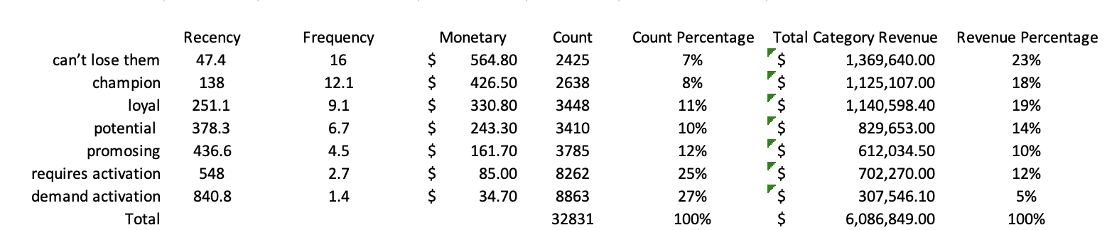
Appendix 1
Top 15% Customer Revenue: $ 2,494,747.00, 41% of total revenue
Other Categories Revenue: $ 3,592,102.00, 59% of total revenue
Total Category Revenue = Monetary Value (mean) * #People in each category

Slide 19
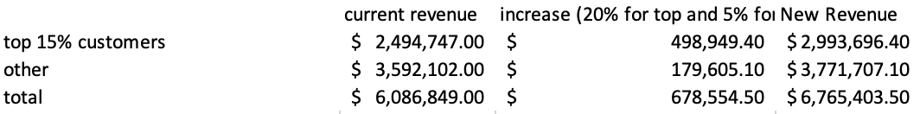
Appendix 2
Graphs for revenue increase are in proportion.
Assumptions:
For top 15% customers, our marketing strategies will increase sales by 20%
For other customers, our strategies will increase sales by 5%

